Slide 1
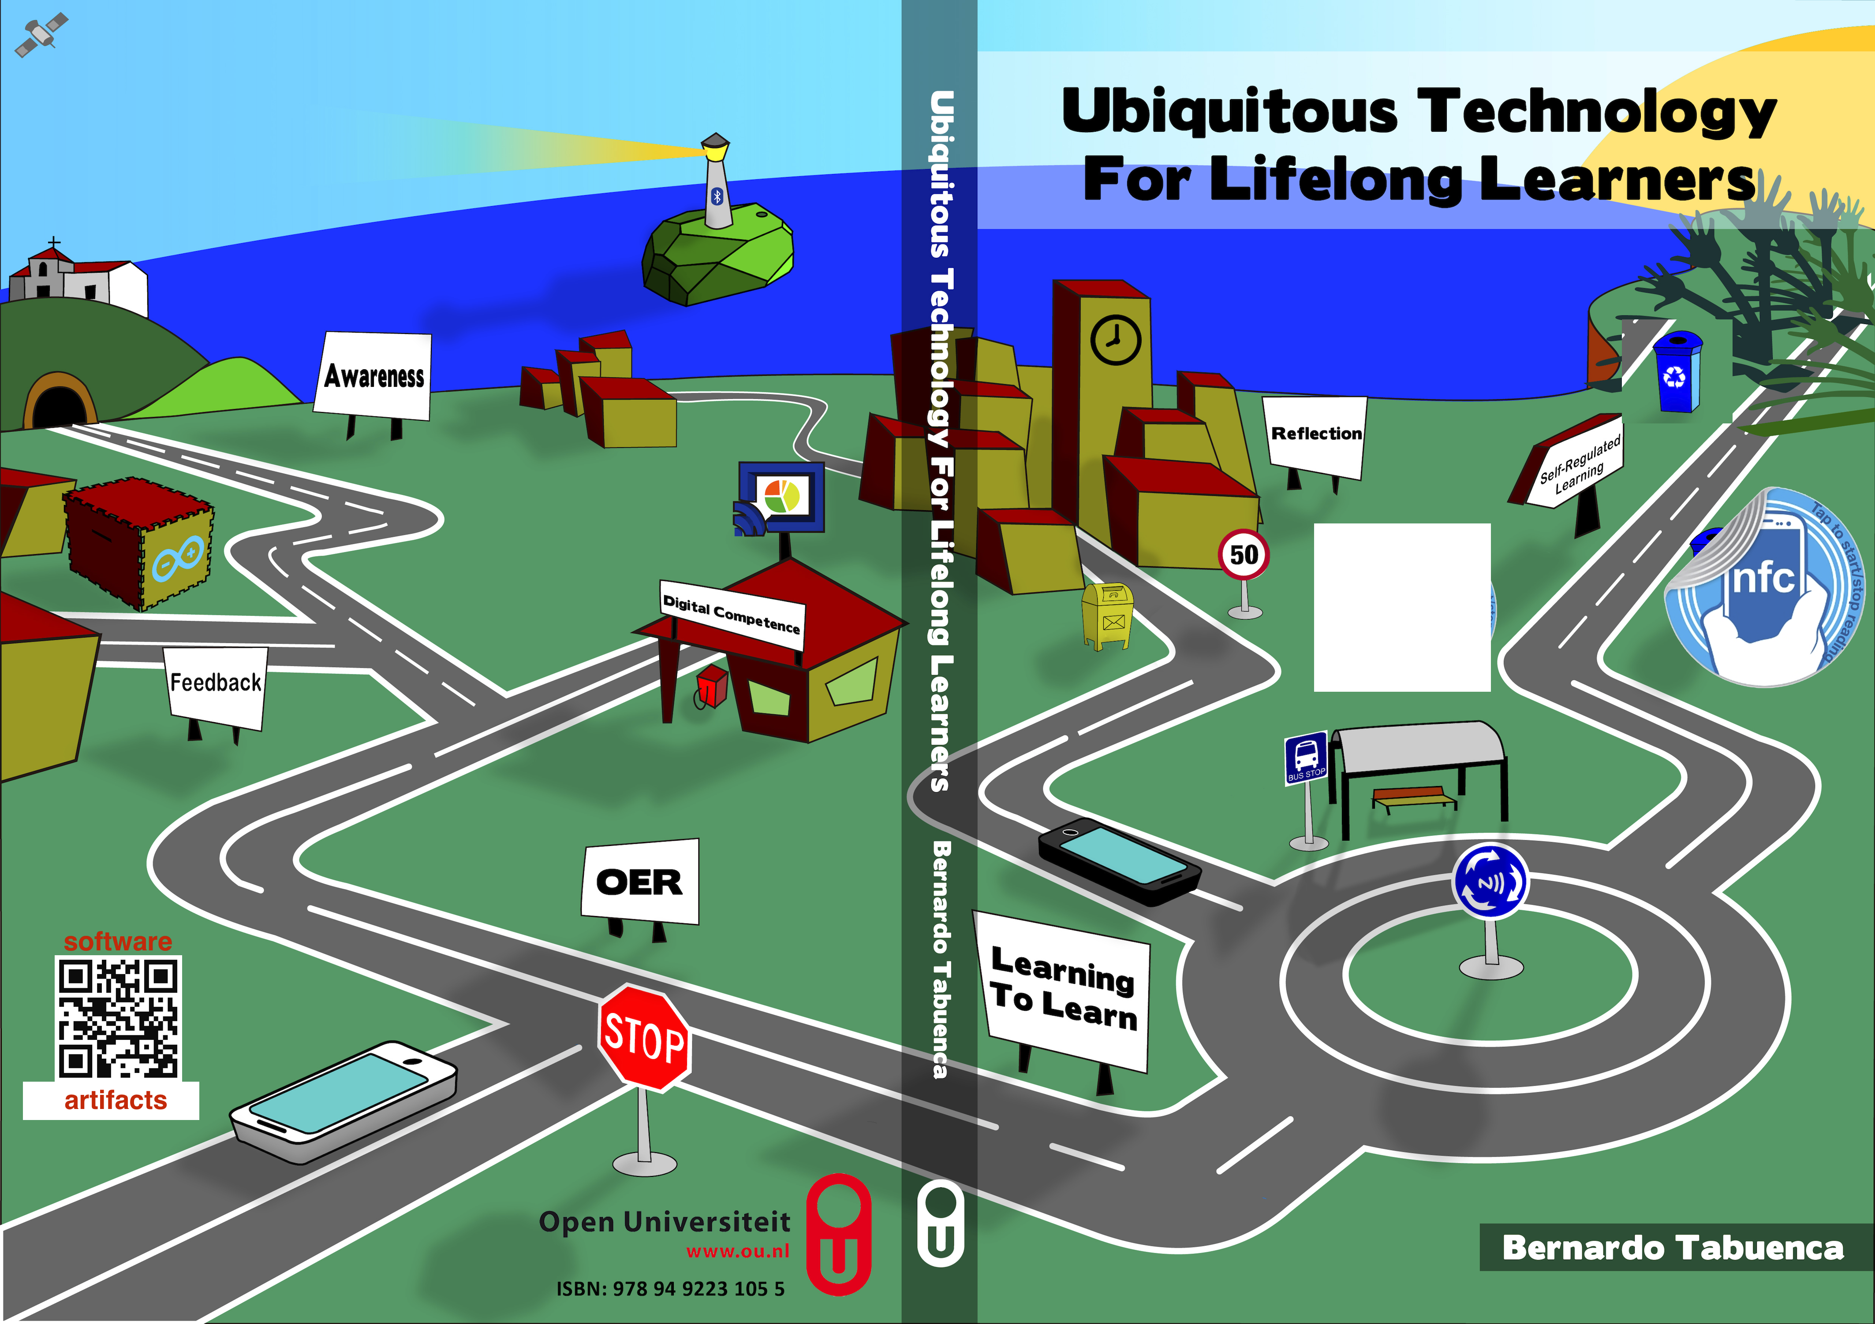
Thesis presentation text

Slide 2
Agenda

Slide 3
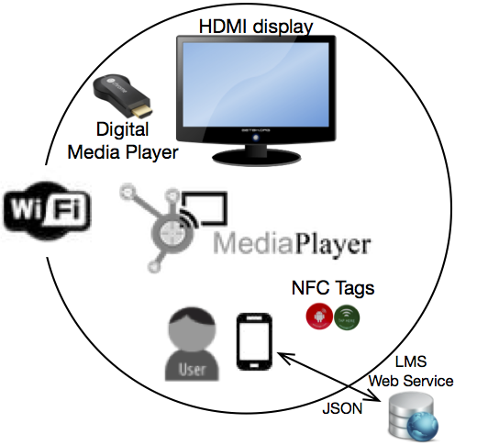
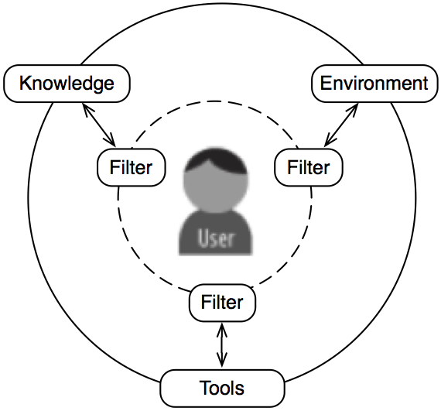
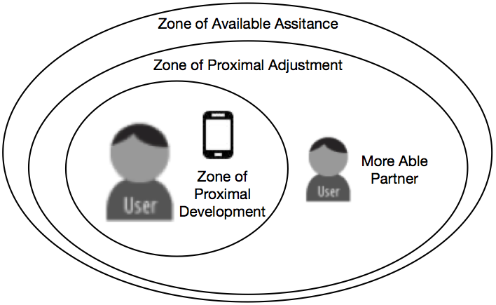
The problem. Scope
Ubiquitous
Technology
Lifelong learners
Notes:
This research aims not at guiding the lifelong learning society towards the accom- plishment of these two competences, but rather at providing cues for individual lifelong learners to foster meta-learning practice supported by technology. Biggs (1985) defines meta-learning as an awareness and understanding of the phenomenon of learning itself. Hereby we conceive meta-learning activities as the increase of knowledge, motivation and self-regulated learning as a result of introspective episodes of reflection by the user to understand how he/she is learning.
Filters are:
seams, wong (See chapter 6)
barriers, fischer kalz
eurostat (time location and confilcts with other barriers),
time, interaction and visualization. Chapter 3
Solutions are :
This ecology increases the chances of learning in scattered moments (i.e. waiting times, commercial break on TV) replacing this perceived “lost time” into perceived “productive time”.

Slide 4
Key competences for lifelong learning
Learning to learn
Digital competence

Slide 5
Technologies enriching daily environments
WI-FI hotspots
NFC tagged objects
Notifications
Open Content
BLE
Arduino. Ambient displays

Slide 6
Key concepts to support lifelong learners
Reflective practice
Self-regulated learning
Feedback
Awareness
Open Educational Resources (Authoring, MOOCS, LOs repos)

Slide 7
Theoretical approach

Slide 8
Formative studies

Slide 9
Empirical findings

Slide 10
Contribution of your thesis
Empirical results
Framework for sampling experiences on mobile devices. Explored dimensions of context
Software artefacts

